Slide 1
Spiritual Gifts Workshop
The Episcopal Church in South Carolina’s Diocesan Convention
Holy Cross Faith Memorial Episcopal Church
Pawleys Island, SC
November 20, 2015
Presenter: The Reverend Jemonde Taylor, Rector
St. Ambrose Episcopal Church, Raleigh, NC

Slide 2
Why are you here?
What do you hope to gain from this session?

Slide 3
What do most Episcopalians you know think about spiritual gifts?

Slide 4
Discerning Your Spiritual Gifts by Fr. Lloyd Edwards
Χάρισμα(charisma)
The word “gift” occurs in two ways in the NT
James 1:17- “Every generous act of giving, with every perfect gift, is from above, coming down from the Father of lights, with whom there is no variation or shadow due to change.”
The primary gift from God is the Holy Spirit. All gifts flow from the Holy Spirit.

Slide 5
Second and more specific use of gift refers to spiritual gifts (gifts for ministry).
1 Peter 4:10-11 Like good stewards of the manifold grace of God, serve one another with whatever gift each of you has received.

Slide 6
Three major references to spiritual gifts in NT:
Romans 12, I Corinthians 12, and Ephesians 4
Romans 12:4-8
For as in one body we have many members, and not all the members have the same function, so we, who are many, are one body in Christ, and individually we are members one of another. We have gifts that differ according to the grace given to us: prophecy, in proportion to faith; ministry, in ministering; the teacher, in teaching; the exhorter, in exhortation; the giver, in generosity; the leader, in diligence; the compassionate, in cheerfulness.

Slide 7
Spiritual Gifts vs. Natural Talents
Difference is stewardship
Frederick Buechner Wishful Thinking
There are all different kinds of voices calling you to all different kinds of work, and the problem is to find out which is the voice of God rather than of Society, say, or the superego or self-interest. By and large a good rule for finding out is this. The kind of work God usually calls you to is the kind of work (a) that you need most to do and (b) that the world most needs to have done.

Slide 8
Finding Your Spiritual Gifts
http://www.elca.org/Our-Work/Congregations-and-Synods/Faith-Practices/Assessment-Tools

Slide 9
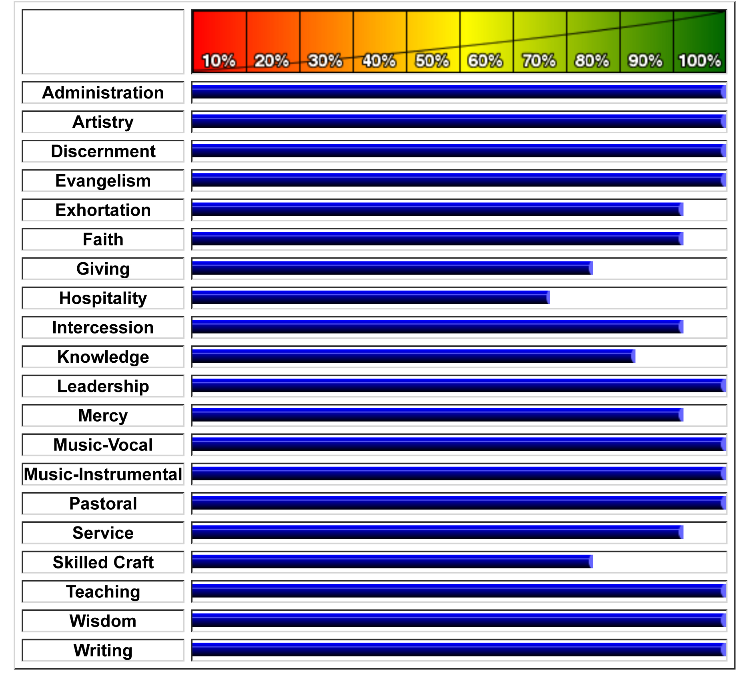

Slide 10
Spiritual Gifts Inventory Results

Slide 11
Wounds, Healing, and Spiritual Gifts
To the extent that our gifts and wounds are related, there is meaning to be found in our suffering and in the particular injuries we have borne. The wounds we have suffered are in some sense the prerequisite for the gifts which we now enjoy.
God does not send the wounds. This does not mean all suffering is always redeemed.
Where we find our wounds, there we will find our gifts. Where our wounds are the deepest, there our gifts are the greatest.

Slide 12
If I had not had this wound, I would not have received this gift.
Gifts
Working with groups
Using language in healing ways
Self-starter, independent
Empathy with people who are hurting
Wound
Parent’s poisonous tongue
Only child
Non-athletic
Father away from home a lot

Slide 13
A Spiritual Gifts and Application “Toolkit”
Called to Transformation Model Overview (Page 2)
  http://calledtotransformation.org/about-c2t/the-model/
Glossary of Terms (Page 5)
A Spiritual Gifts Assessment Tool from the Lutheran Church (ELCA) (Page 6)
http://www.elca.org/Our-Work/Congregations-and-Synods/Faith-Practices/Assessment-Tools
Discerning Your Spiritual Gifts book by Lloyd Edwards (Page 7)
Studying Your Congregation and Community Website (The Episcopal Church) (Page 8)
  http://www.episcopalchurch.org/page/studying-your-congregation-and-community
An Excerpt from The ExecutiveInsite Report Demographic Study from the Studying Your Congregation and Community Website (Page 9)

Slide 14
Congregations may use these tools to help determine what spiritual gifts God gives people in a particular parish (Spiritual Gifts Assessment), the assets and desires of the community surrounding the parish (Studying Your Congregation and Community Website), and how to practically use the spiritual gifts God gives a congregation to reach and impact the surrounding neighborhood (Discerning Your Spiritual Gifts book and the Called to Transformation website). These are practical steps congregations may use to discover and deepen parish spirituality while engaging geographic neighbors.

Slide 15
